Slide 1
Energy, Population &
Temperature Data Analysis
Exploring how energy consumption impacts temperature changes
across countries
University Project | Data Analytics

Slide 2

1
What data was gathered?
For this project we have chosen the following:
Local csv and JSON files
A web API (Direct)
Kaggle API
Dataset called energy-use-per-person extracted from https://ourworldindata.org/energy.
Population data was retrieved directly from the World Bank website https://data.worldbank.org/indicator/SP.POP.TOTLAPI using the pandas_datareader.wb module.
The temperature dataset was programmatically downloaded from Kaggle using the Kaggle.api.datase_download_files command.

Slide 3

2
Data extraction.
Our dataset are in three different formats:
Energy data as: csv file extracted from a ZIP folder as per the below
Population data extracted from the World Bank API as per below
Temperature data extracted from Kaggle ZIP csv file.
From those files, we have combined three different datasets to study and extract how energy consumption has impacted the temperature changes across different countries.

Slide 4

3
The process was followed as:
1
Collecting data from multiple sources (CSV, API, Kaggle)
2
Data cleaning
3
Data integration and feature engineering
4
Data storage
5
Exploratory data analysis
6
Visualisation
7
Conclusion

Slide 5

4
The required cleaning steps were followed as:
Renaming columns for data standard names across all sources,
Converting fields and numeric values for consistency in data types,
Removal of duplicate values,
Checking units of measurement for energy and temperature variables,
Filtering datasets to the same time period (2014-2022) across all sources.

Slide 6

5
Main challenges found while integrating the data as:
1. Country name mismatches
2. Data structures
Example: "Viet Nam" vs "Vietnam", "Yemen, Rep." vs "Yemen". Then the join has failed.
Solution discussed to solve this problem: By creating a mapping dictionary to standardize names and to avoid missing country during the merge process because a simple comma or misspelling.
Population data from the world bank api required more cleaning as it did not have matching country codes while energy and temperature data had.
Required different merge keys as: Merging energy and temperature data, then merging with cleaned data population.
3. Appearance of more duplicate values
4. Data alignment
After data standardization names that was fixed by removing duplicates by using .drop_duplicates() to ensure that will be no errors while merging data.
Missing countries in the datasets as even after fixing names, not every country were found across the dataset.
Fixed by finding common countries name across the dataset to ensure the final analysis only included complete data points.

Slide 7

6
Storing Data
Data was stored in two ways to ensure portability and scalability.
Final unified dataframe: All data points were consolidated into a single Pandas Dataframe for immediate analysis.
NoSQL Database (MongoDB): The cleaned data was exported to a MongoDB collection. This step allows efficient querying and storage of the country-year data as individual documents.
CSV Export: A flat file named cleaned_merged_energy_population_temperature.csv was generated for easy sharing and backup.
6.1 The stored dataset includes:
Identifiers: Country name and Country Code,
Temporal data: Year,
Demographics: Total population,
Energy metrics: Annual mean temperature and 5 years smoothed temperature.
Engineered features: Total_Energy_Proxy (calculated as Population × Energy per capita).

Slide 8

7
Insights we can get from the data
Total energy consumption (proxy): Population vs Energy per Capita.
The national footprint was reconstructed by multiplying it by population. Data was per person. Then it was converted to Terawatt-hours (TWh) as a crucial step for interpreting data. This is used by global energy agencies.
Identifying Correlations
Population vs Energy to determine if a country's energy footprint is driven by its sheer size or by the lifestyle of its citizens. Having the annual_mean and energy metrics side-by-side, we can visualize whether the highest energy consumers are also experiencing the most rapid local temperature changes.
Climate Bands (Binning)
The use of discretization to turn continuous temperature into categorical bands was taken. This allowed us to create comparative visualizations as example: boxplots to understand if there are differences in the energy consumption between hot and cold countries.
Data Driven: High Energy Use Flag
This is an outlier detection technique to flag countries that exceed a certain threshold, making it easier to identify heavy consumers for further analysis.
Temperature Smoothing
It was used to filter out noise(if around) to reveal the actual climate trend.

Slide 9

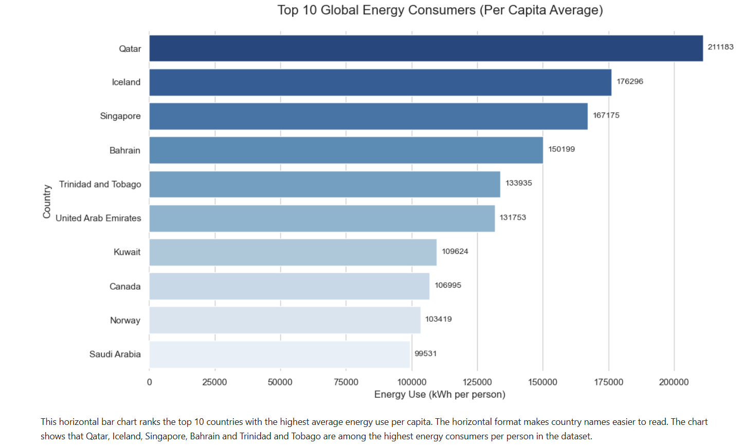
8
Visual Analysis
Screen grabs to be added

Slide 10
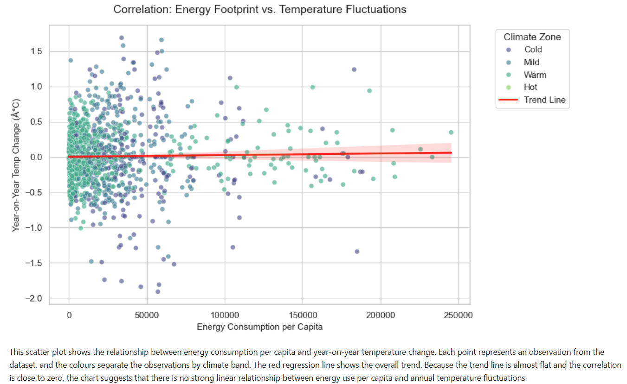
8
Visual Analysis
Screen grabs to be added

Slide 11
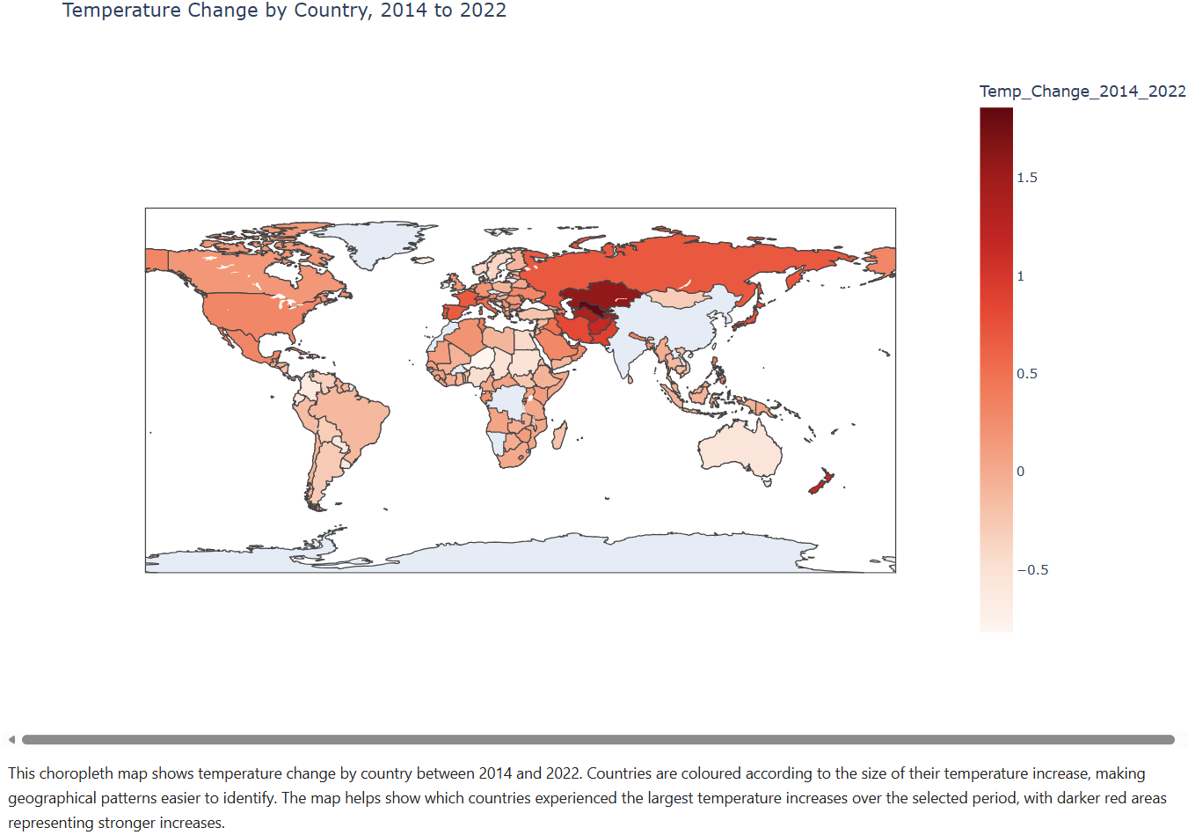
8
Visual Analysis
Screen grabs to be added

Slide 12
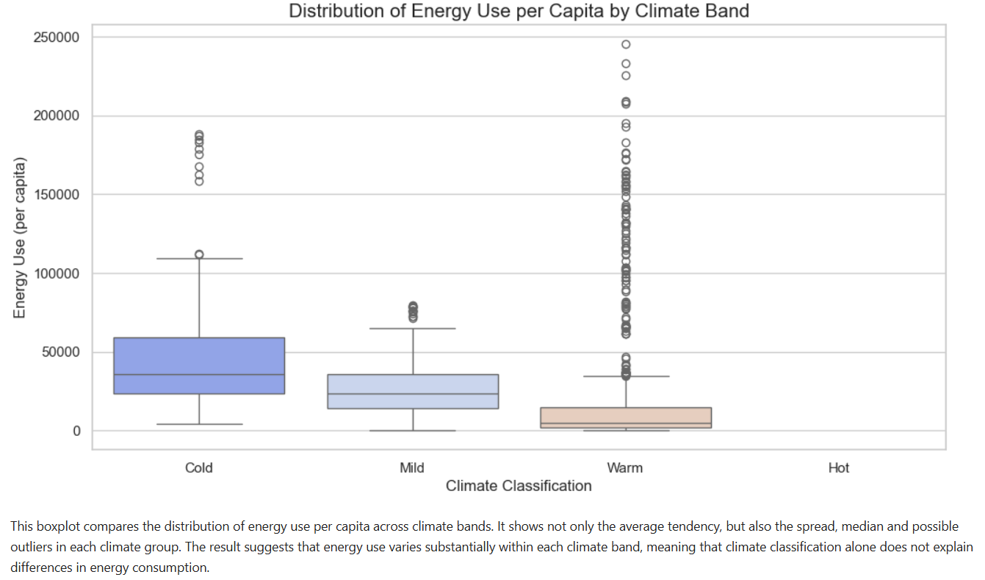
8
Visual Analysis
Screen grabs to be added

